Slide 1
Income Analysis
Hetansh Patel

Slide 2
ABOUT Data
The dataset contains 16 columns.
Target filed: Income
The income is divide into two classes: <=50K and >50K
Number of attributes: 14 - These are the demographics and other features to describe a person
We can explore the possibility in predicting income level based on the individual’s personal information.

Slide 3
Data collection
Data Website: https://www.kaggle.com/datasets/wenruliu/adult-income-dataset/data

Slide 4
Pre-Processing

Slide 5
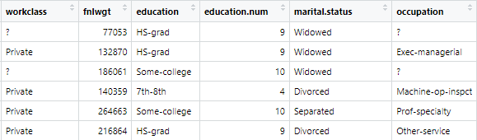
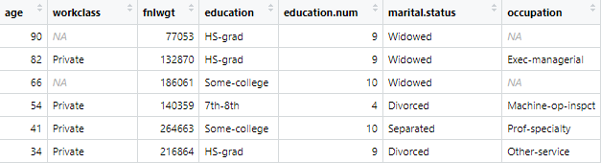

Pre-Processing
Before
After

Slide 6
Handling NA values
There were NA values in following columns:
Workclass
Occupation
Native Country
All of them are Character type. So we can’t just apply random values inside them. Its better to delete the entire rows rather than giving misleading information.

Slide 7
Data Exploration

Slide 8
Reviewing each feature
Age - Age of a Person
Workclasss –Type of workclass (i.e. Private, Government, Self-Employed, Others)
Fnlwgt – This stands for Final weight.(Represents the number of people that an observation in the dataset represents in a sample)
Education – Education level of a person
Education.num – Numerical representation of education level(Number of years of education)
Marital.status –Marital status of a person(i.e. Married,divorced, etc.)
Occupation – Type of occupation
Relationship – Relationship Status(i.e. Wife, Husband, Not in family, etc.)
Race – Ethnicity of Person
Gender – Gender of a person
Capital.gain – Financial gain of individual from investments or capital assets.
Capital.loss – Financial loss of individual from investments or capital assets.
Hours.per.week – Number of hours a person works per week.
Native.country – Native country of an individual.
Income(Target Variable) - Income of a person(less than or more than 50K)

Slide 9
Data Transformation

Slide 10
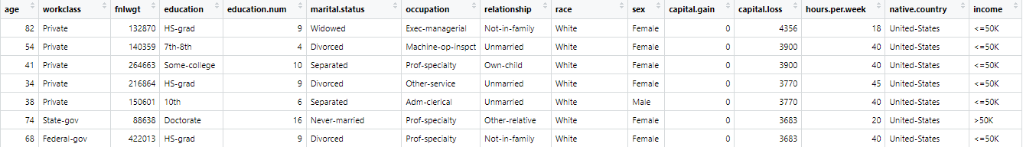
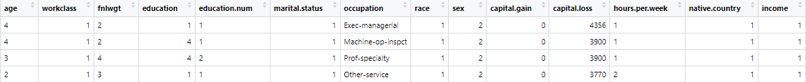
Giving categories
Transforming character data into categorical variables. This transformation will make our data set more compatible with more statistical techniques. Categorizing each character column to numerical codes, simplifying data while retaining its essential information. This process enhances our dataset’s suitability for statistical analysis, setting the stage for deeper exploration and insights.

Slide 11
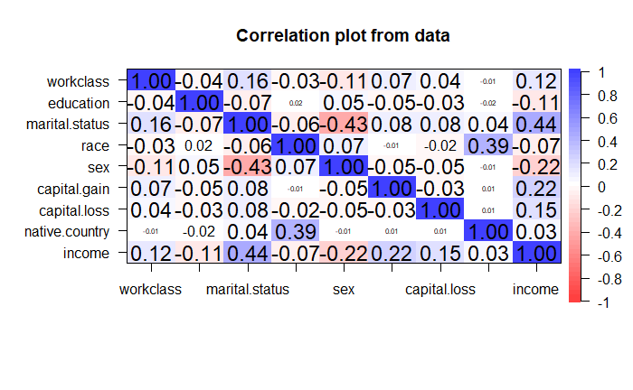
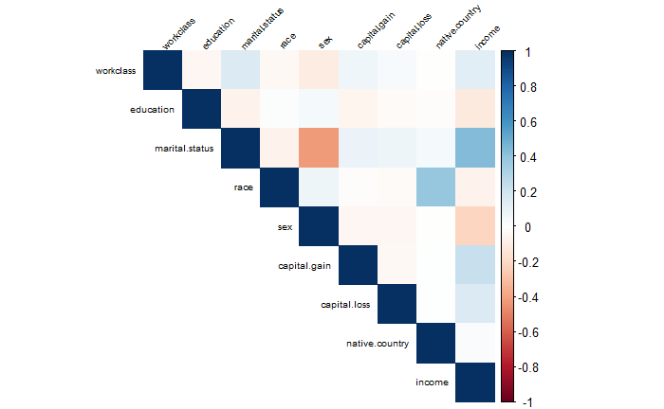
Correlating data
Objective of this was to discern which features within the dataset held the most relevance and which ones were less informative. This process allows us to gain insights into the interrelationships between different variables. It is important to eliminate less influential features to reduce dimensionality and enhancing the efficiency of our analysis. This approach to data reduction ensures to focus more on critical aspects of data.

Slide 12
Data Visualizing

Slide 13
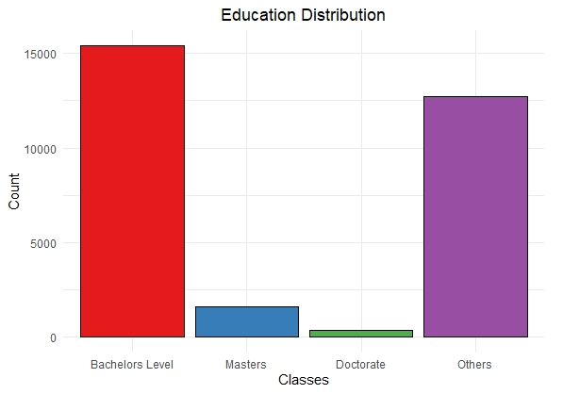
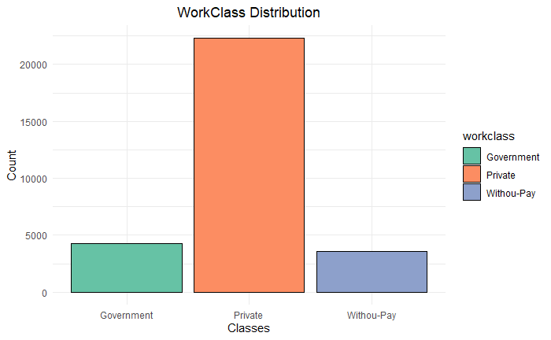
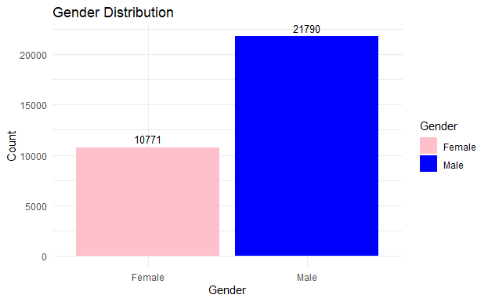
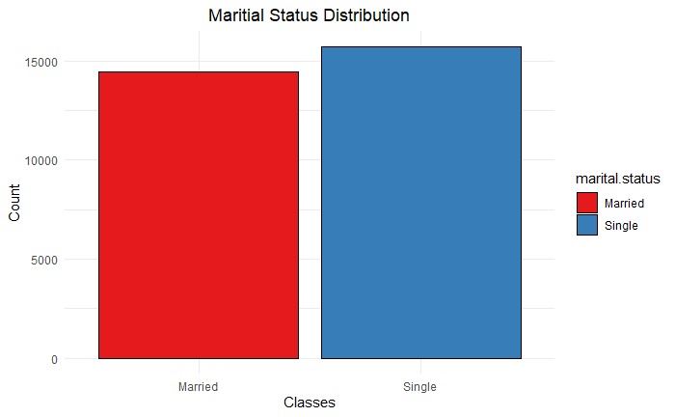
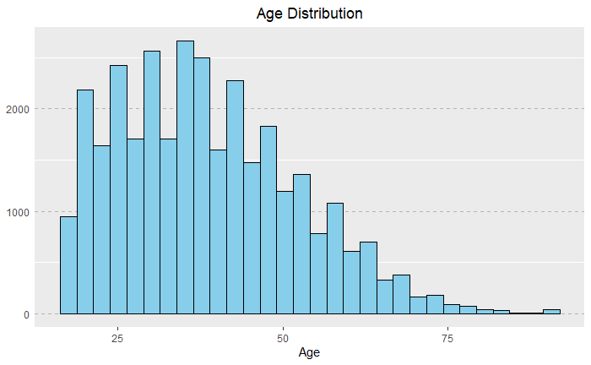
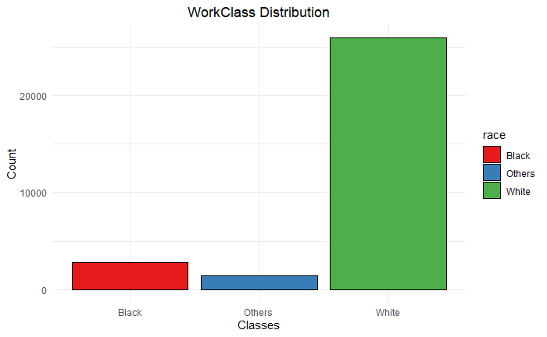
Overview of data

Slide 14
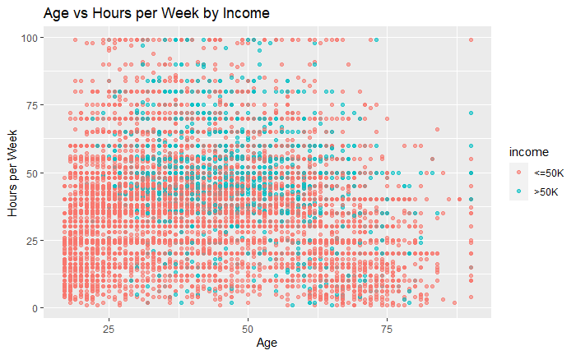
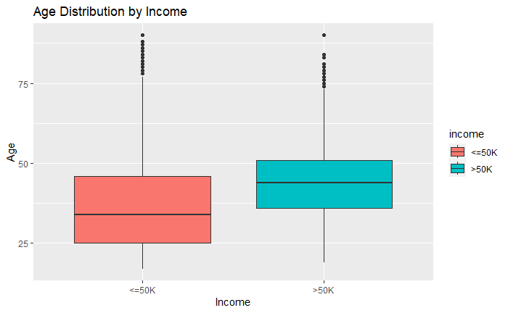
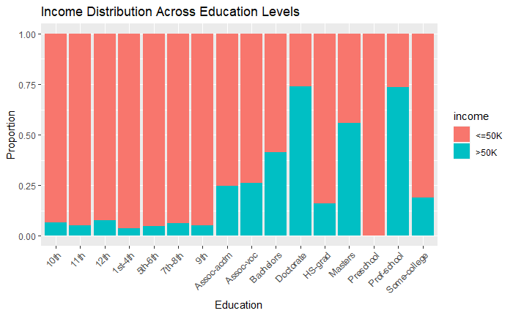
Overview of data

Slide 15
Methodology

Slide 16
Algorithms
Decision Trees
Random Forest
Support Vector Machines
Naïve Bayes
Logistics Regression
XGB Tree
KNN

Slide 17
Results

Slide 18
Metrics used
Sensitivity
It measures the ability of a model to correctly identify positive instances among all actual positive instances.
Specificity
It measures the ability of a model to correctly identify negative instances among all actual negative instances.
Kappa
Cohen’s Kappa is a statistic that assesses the level of agreement between a model’s predictions and the actual values.
Accuracy
It measures the percentage of the correctly predicted instances(both true positives and true negatives) out of all the instances in the dataset.

Slide 19
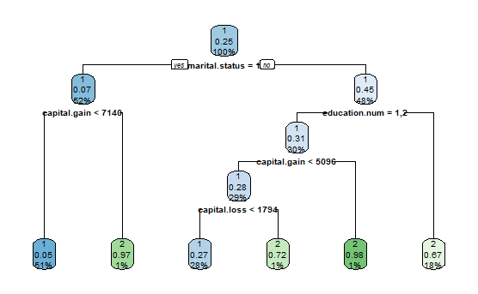
Tree Classification
Metric | Value
Accuracy | 0.85
Sensitivity | 0.94
Specificity | 0.57
Kappa | 0.56

Slide 20
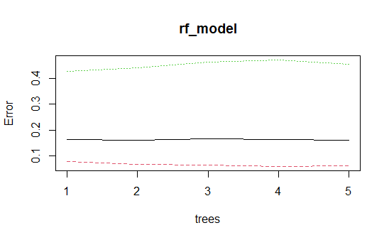
Random Forest Classification
Metric | Value
Accuracy | 0.847
Sensitivity | 0.94
Specificity | 0.54
Kappa | 0.54

Slide 21
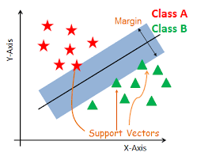
Support Vector Classification
Metric | Value
Accuracy | 0.84
Sensitivity | 0.93
Specificity | 0.55
Kappa | 0.53

Slide 22
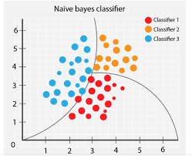
Naïve bayes Classification
Metric | Value
Accuracy | 0.80
Sensitivity | 0.94
Specificity | 0.36
Kappa | 0.37

Slide 23
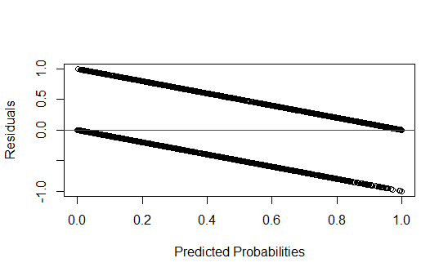
Logistic regression
Metric | Value
Accuracy | 0.838
heteroscedasticity

Slide 24
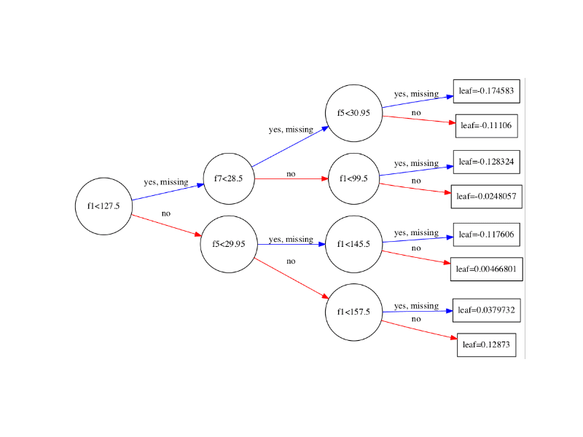
XGB tree Classification
Metric | Value
Accuracy | 0.86
Sensitivity | 0.94
Specificity | 0.61
Kappa | 0.59

Slide 25
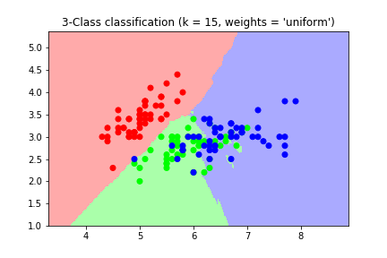
KNN Classification
Metric | Value
Accuracy | 0.855
Sensitivity | 0.94
Specificity | 0.58
Kappa | 0.56

Slide 26
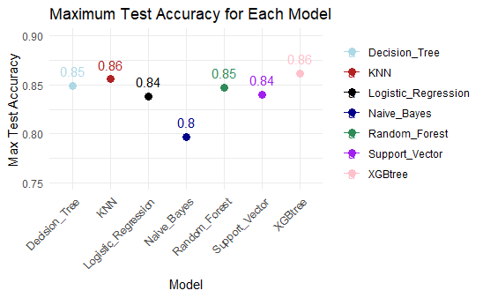
accuracy
Bar Chart

Slide 27
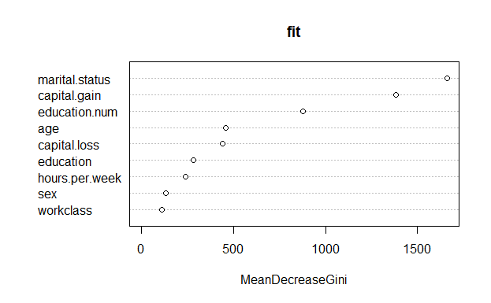
Importance of features

Slide 28
Best model
For efficiency :
Desicision Tree
For Better Accuracy:
XGB TREE

Slide 29
Use Cases
Credit scoring
Financial institutions can use the analysis to assess an individual's creditworthiness. By considering income, employment, and other factors, they can make informed decisions on lending and setting interest rates.
Marketing
Companies can target their marketing efforts more effectively by understanding the income and demographic profiles of their customers. This can lead to personalized advertising and product recommendations.
Government policy
Governments and policymakers can use the analysis to design and evaluate social programs, tax policies, and measures aimed at reducing income inequality or improving economic conditions for specific demographic groups.
Education planning
Educational institutions can use the information to create targeted scholarship programs, improve educational outcomes, and provide resources to students from underprivileged backgrounds.

Slide 30
THANK YOU
Any Questions?

